Slide 1
BizInnovate DATATHON SOLUTION PROPOSAL
JUSTIN LOOK
MII HIRAYAMA
PARSHAN JAVANROOD
ARISARA SRISUTHISURIYA

Slide 2
TABLE OF CONTENTS
01
02
03
PROBLEM
METHODOLOGIES
RECOMMENDATION
Evaluate impact of Clean Inc. in alignment with the SDG of clean water
Estimate water quality index from satellite images
Other suitable KPIs

Slide 3
PROBLEM
01
Evaluate Clean Drop Inc.’s new solution to improve safe water access (in parallel with SDG of clean water and sanitation)
Estimate the water quality index derived from recently collected Land Stat satellite images

Slide 4
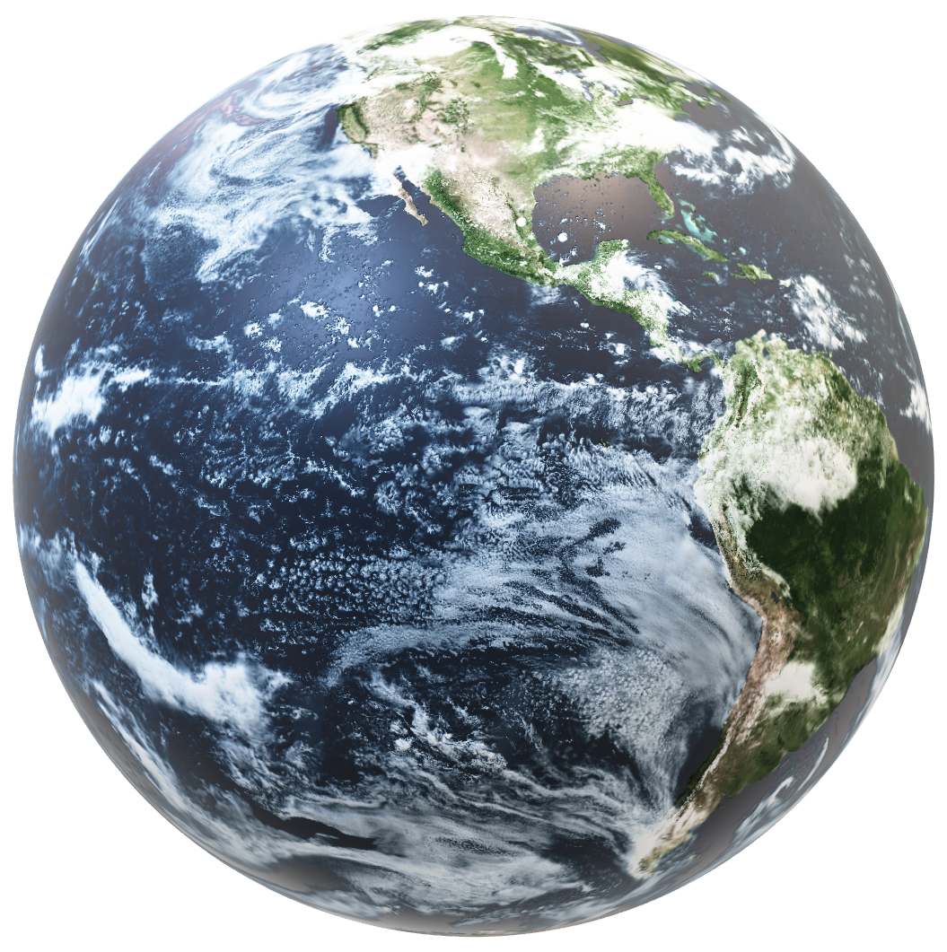

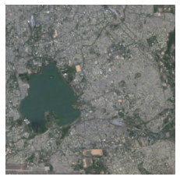
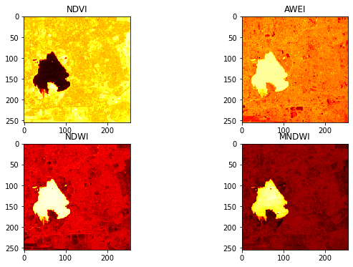
METHODOLOGIES
Explored the shape of the NumPy array and identified the wavelength that each entry represents

Slide 5
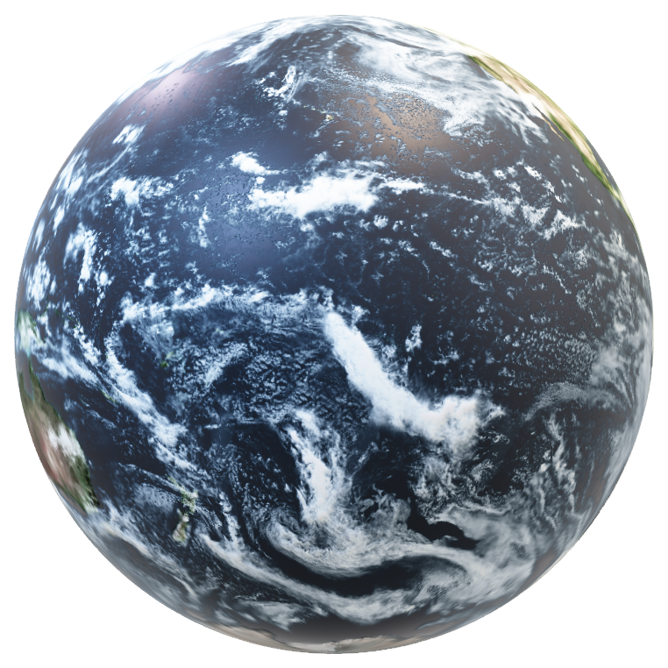
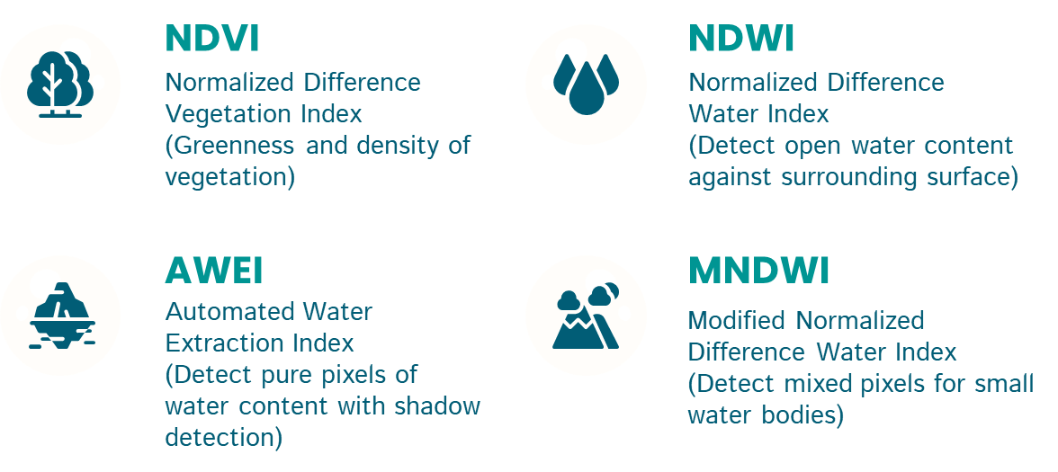
METHODOLOGIES

Slide 6
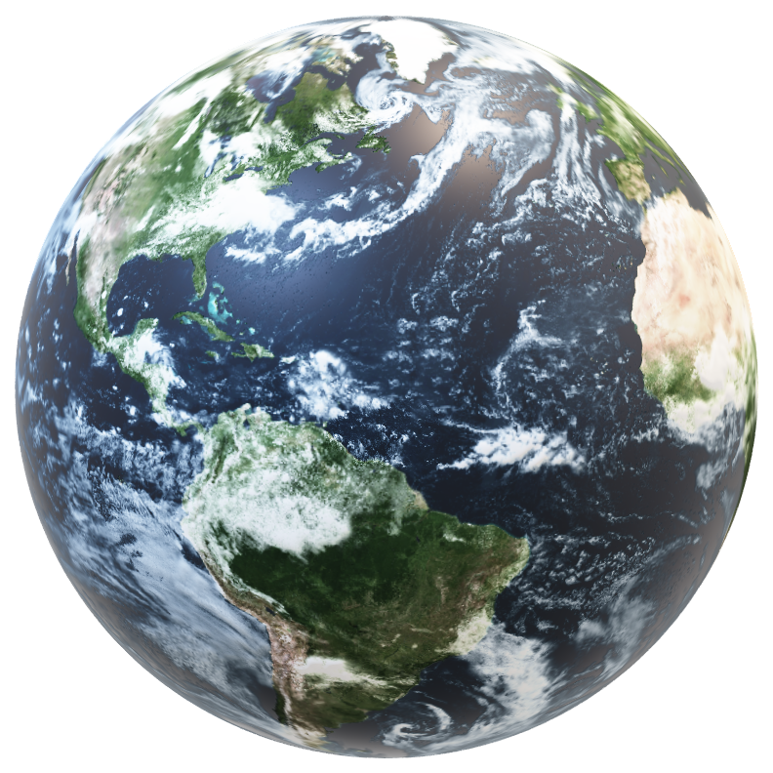
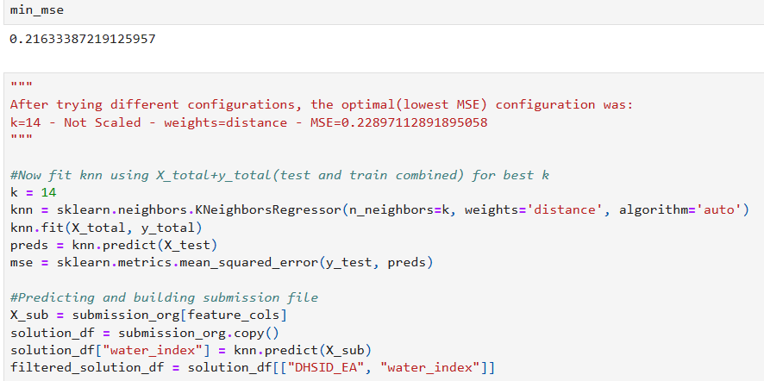
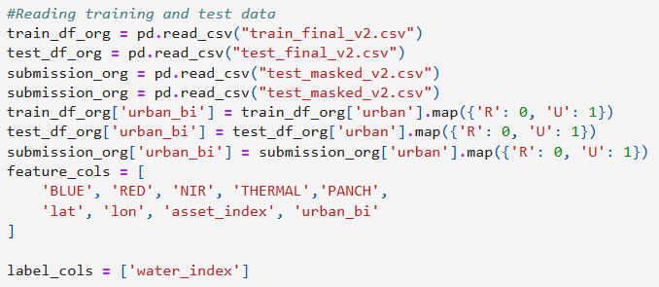
METHODOLOGIES
Split “train.csv” into training and test data
Convert “urban” to binary values
Choose explanatory variables
Run KNN regression (K=14) with the smallest MSE
Estimate water quality index of “test_masked.csv”

Slide 7
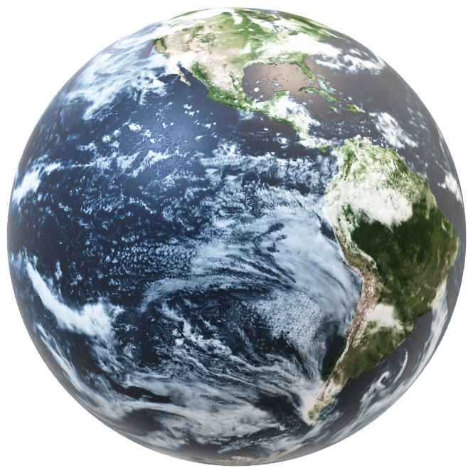
LIMITATIONS
EFFECT OF ENVIRONMENTAL NOISE
Accuracy of surface water detection
PROCESSING POWER
Run more complex models (CNN etc.)
WEAKNESSES OF KNN REGRESSION
Slow with large training data

Slide 8
RECOMMENDATION
03
Water-Associated Disease Index (WADI)

Slide 9

Water-Associated Disease Index (WADI)
Identify and visualize vulnerability to different water-associated diseases
Align with the target under SDG clean of clean water to end defecation
Link Clean Inc’s innovation performance to actual results in elevating people out of calamities devastation

Slide 10
THANKYOU

